Slide 1

What contributes to Happiness?
Happiness and its contributing factors
By
Assistant Cisse, Diana Borkar, Merelynn (Lynn) Okang & Gloria Yahouedeou

Slide 2



WHY THIS TOPIC?
Everyone wants to be happy
Good and reputable data set to explore the topic
Understanding factors that contribute to happiness across countries
QUESTIONS TO ANSWER
Is there consistency in what determines happiness across countries?
Are life expectancy and GDP the best indicators of happiness across countries?
Based on the World Happiness Report, World Bank Life Expectancy data set, and the Human Freedom Index, could we predict happiness in from one year to the other ?

Slide 3


Data Source
Our assumptions:
Aside from GDP, Life Expectancy & Freedom are import factors to happiness
With data from 2018 or 2019, we could predict the following year happiness rank.
Data sets:
The World Happiness Report: a landmark survey of the state of global happiness with a collection of indicators on more than 140 countries around the world including happiness rank, happiness score on a scale of 0 to 10, standard error, and more…
The World Bank Life Expectancy data set
The Human Freedom Index
World Happiness Report
World Bank Life Expectancy
the Human Freedom Index
Notes:
In order to address our main question, we used various data sets.
The main dataset being used is a collection of data from the World Happiness Report. It is a landmark survey of the state of global happiness. The data set has a collection of indicators on more than 140 countries around the world including happiness rank, happiness score on a scale of 0 to 10, standard error, and more… The data set includes reports from 2015 to 2016, which we decided to focus on for our machine learning model.
We will also be using the World Bank Life Expectancy data set and the Human Freedom Index, to compare against (for the years that align with our main data set) using the same years as indicators.

Slide 4




Technology Used
Python
Jupyter Notebook
Pandas
Google Collab
AWS
Postgres

Slide 5
Data Exploration
1st Goal : Align three data sets to find correlation in what determines happiness across countries based on life expectancy and freedom in 2018 and 2019.
We started by hosting the data sets in AWS and linking them to PostgreSQL.
Issues:
Data set alignment
World Happiness Report data set from 2015 to 2019
World Bank Life Expectancy data set from 1960 to 2018
Human Freedom Index data set from 2008 to 2016
Data set structure
Country name cleanup
Null and NaN
Duplicates

Slide 6
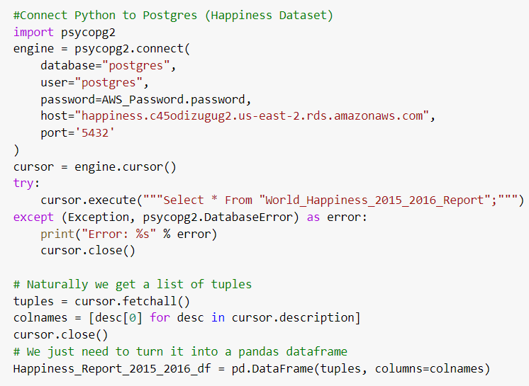
Preprocessing
Connect Python to Postgres database
Get data set hosted in Amazon Web Services (AWS)
Define data frame using pandas

Slide 7
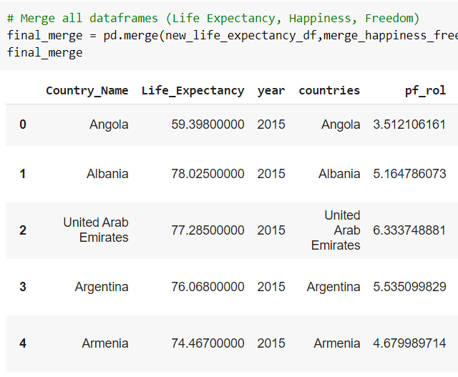
Data Cleanup
Remove NaNs using df.dropna()
Drop duplicates on each data frame using df.drop_duplicates()
Final Merge using pd.merge()
Used pd.DataFrame to focus on key columns
Check for null values using df.isnull().sum()
Notes:
All trough out the preprocessing stage, we systematically cleaned up each of the tables we wanted to use to focus on the minimum required fields to create a merged data set incorporating:
The same year (2015-2016)
Same country name
Same amount of data with no null or duplicates
First, we cleaned up and merge the 2015 and 2016 world happiness data frame, then did the same for the human freedom index data frame, followed by the life expectancy data frame, and finally we merged all three into one final data frame

Slide 8
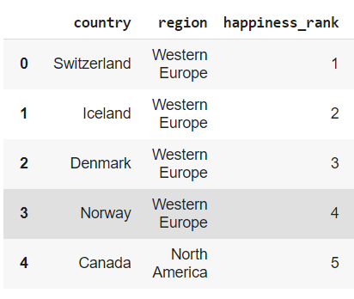
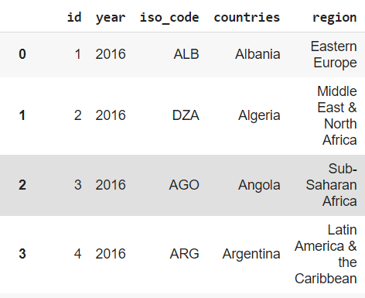
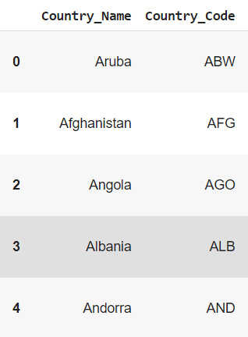
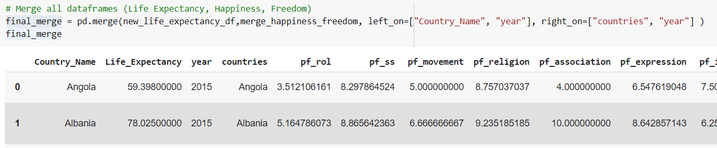
Happiness_Report_2015_2016_df
Human_Freedom_Index_df
Life_Expectancy_df
final_merge

Slide 9
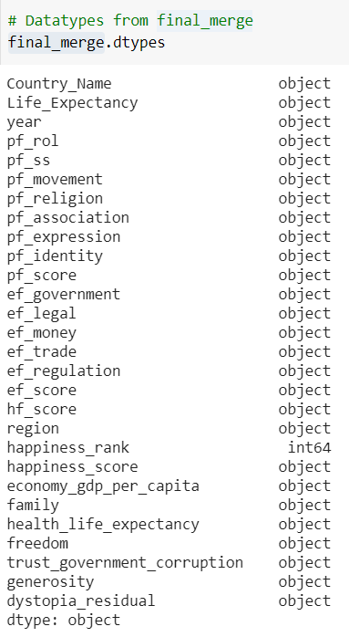
Merged Columns
Happiness Data set:
GDP per Capita, Family, Life Expectancy, Freedom, Generosity, Trust Government Corruption, Dystopia Residual, Region, Happiness Rank & Happiness Score
Life expectancy Data Set:
Life expectancy at birth, total (years) & Year
Freedom Data Set:
Rule of Law, Security and Safety, Movement, Religion, Association, Assembly, and Civil Society, Expression and Information, Identity and Relationships, Size of Government, Legal System and Property Rights, Access to Sound Money, Freedom to Trade Internationally, Regulation of Credit, Labor, & Business

Slide 10
Machine Learning Model – Linear Regression
Why this model?
The output is continuous
Help find a line that best fits the data
Split into training and testing
Trained on 2015 data
Tested on 2016 data
Confusion matrix
Notes:
Linear regression is a linear approach to modeling the relationship between a dependent variable and one or more independent variables. In simpler terms, it is the ‘line of best fit’ that represents a dataset. In this case, our dependent variable was the happiness score, and the independent variables were the features (columns).
Linear regression assumes there is a straight-line relationship between them. Sometimes this is incorrect. For example, the relationship between income and age is curved, i.e., income tends to rise in the early parts of adulthood, flatten out in later adulthood and decline after people retire.
Linear Regression Only Looks at the Mean of the Dependent Variable. Linear regression looks at a relationship between the mean of the dependent variable and the independent variables. For example, if you look at the relationship between the birth weight of infants and maternal characteristics such as age, linear regression will look at the average weight of babies born to mothers of different ages. However, sometimes you need to look at the extremes of the dependent variable, e.g., babies are at risk when their weights are low, so you would want to look at the extremes in this example.

Slide 11
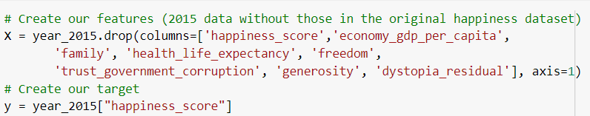
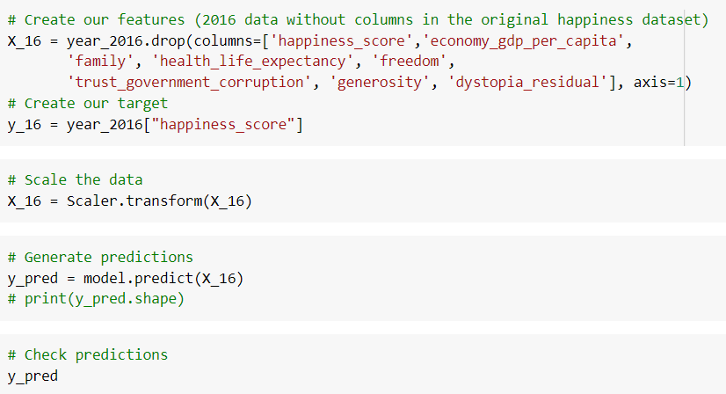
Split train and test
Trained on 2015 data
Tested on 2016 data
Notes:
Trying to create linear regression model.
Included happiness data in model and it biased the model since it is what was used to create the happiness score 99%
38-48% accuracy rate
Accuracy score was low no matter which combination of feature to try
Slip data 2015 training
2016 testing higher accuracy

Slide 12
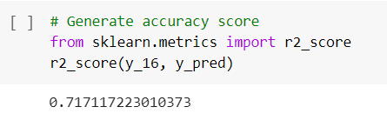
Data Analysis
Used supervised linear regression model to predict the happiness scores of countries
The features are all columns not part of the original happiness dataset ('happiness_score','economy_gdp_per_capita’, 'family', 'health_life_expectancy', 'freedom', 'trust_government_corruption', 'generosity', 'dystopia_residual’)
Train on 2015 data and tested on 2016 data
Accuracy score of 71.71%

Slide 13
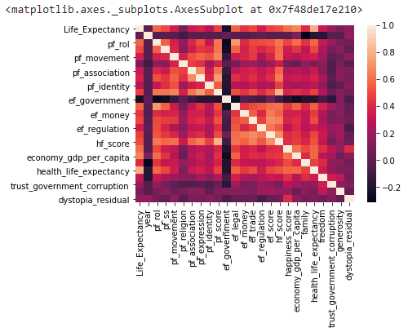
Correlation Matrix
Correlation between ‘Life Expectancy’ and ‘Happiness Score’ of 0.79. This may be because education is more established and prevalent in wealthier countries.
Correlation between ‘GDP per Capita’ and ‘Happiness Score’ of 0.80.
Moderate correlation between ‘Rule of Law’ and ‘Happiness Score’ of 0.70.
Notes:
Correlation between ‘Schooling’ and ‘Life Expectancy’ of 0.73. This may be because education is more established and prevalent in wealthier countries. This means countries with less corruption, infrastructure, healthcare, welfare, and so forth.
Strong correlation between ‘GDP per Capita’ and ‘Happiness Score’ of 0.80. This may be because with capital gain comes access to better infrastructure, health care, which are important (to various degrees) to all.
Moderate correlation between ‘Rule of Law’ and ‘Happiness Score’ of 0.70. This may be because with rule of law comes order and security, which in turn put people at ease to be happy.
The least relevant factors seemed to be religion, generosity, and trust in the government.

Slide 14

Dashboard
Demo

Slide 15
Dashboard Visualizations

Slide 16
Dashboard Interactive Visualizations

Slide 17

Thank you!

